Slide 1

Student Record Management
System
SUBMITED BY:
Shubham D. Pagarwar
Arvind K. Rahangdale
Rajni A. Bisen
Nikki K. Katare
Devendra P. Bante
Swapnil Dumbhare
DEPARTMENT OF COMPUTER ENGINEERING
GOVERNMENT POLYTECHNIC GONDIA

Slide 2

What we Say?
A Student Management System (SMS) is designed to help collages for management of dental student.
The Student Record Management System avoids an complexity of managing the student record mannualy on the paper.

Slide 3
Use JDBC Technology
JDBC(Java Database Connectivity) is a Java API for connecting programs written in Java to the data in relational databases.
There are mainly Two approaches for JDBC:
1.JDBC-ODBC Approach
2.Pure JDBC Approach
But JDBC-ODBC does not support every operating system. Because some OS does not contain DSN driver for oracle . So we use Pure JDBC approach.

Slide 4
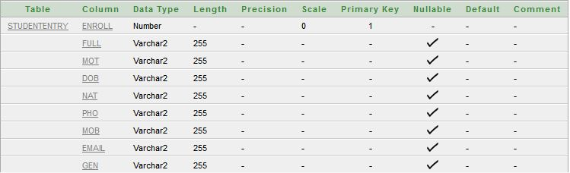
Create an Backend
After establish the connection using JDBC we creates an database tables in the oracle 10g for storing the record of an student.

Slide 5
Create GUI using swings
Making an different frames for establishing Graphical user interface using swing . There are different classes of AWT component are used in the project . Ex. Jbutton , JtextField .
A graphical user interface (GUI) presents a user-friendly mechanism for interacting with an application. We cover other
GUI components as they’re needed throughout the rest of the book.
The most widely used events are those defined by the AWT and those defined by Swing. This chapter focuses on the AWT events . we use event handling interfaces like ActionListener .

Slide 6
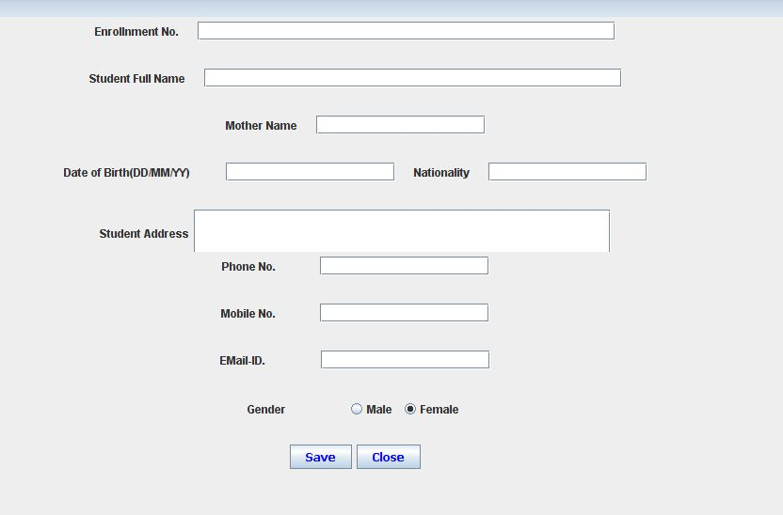

Slide 7
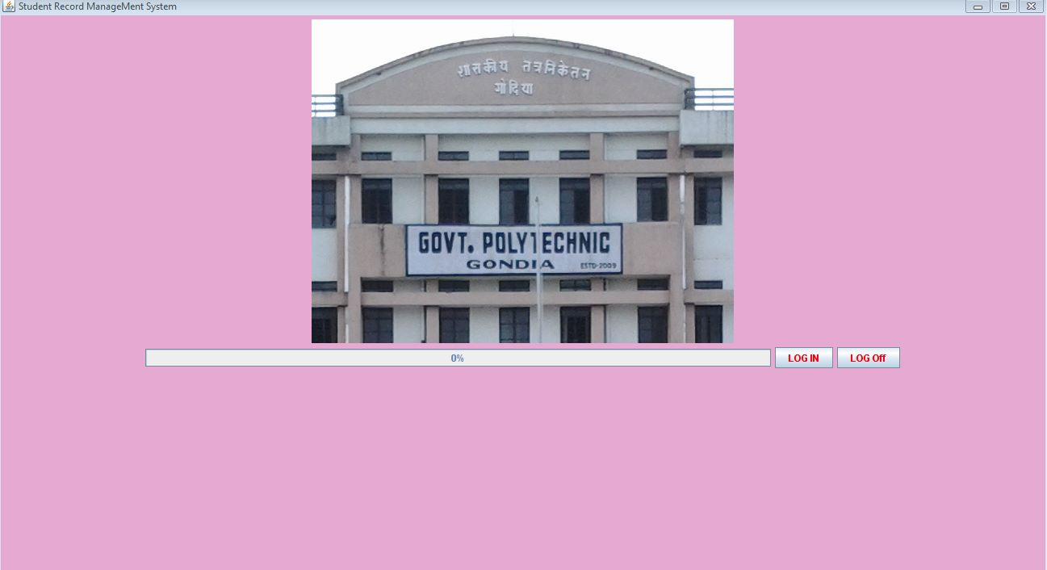
Log-in Page

Slide 8
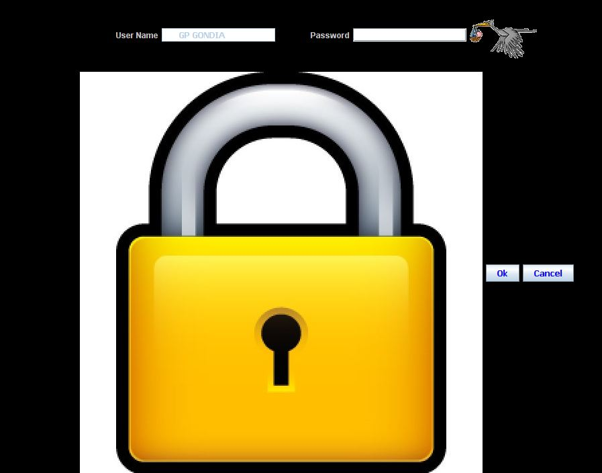
Provides Complete Security of Record

Slide 9
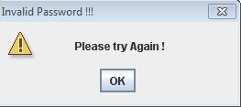
Security
Our System has been Secured . User name of an System is GP GONDIA is default. So username is non-editable. And our System Password is “gpg2014”.
If we give wrong password , than it gives an appropriate message in Dialog box .

Slide 10
Main Menu
After authenticate the user name and password , system move towards the main menu of an project.
In Main Menu project all the menu are coverd as follow:
Admission of an Student
External Marks of an Student
Internal Marks of an Student
Library System of an Student
Report Generation of an Student
About

Slide 11
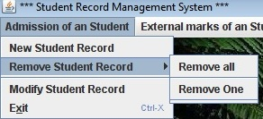
Menus:
All Menu are Successfully designed . But Library system are not completed because of less duration.
Firstly , In Demonstration of an project we think about the giving details of all lab manuals of student . But for these large duration are needed . But these is not possible, so we does not give the detail of manuals.

Slide 12
Use of Client-Server concept
The client/server architecture is one of the most common solutions to the conundrum of how
to handle the need for both centralized data control and widespread data accessibility.
In client/server systems, information is kept relatively centralized (or is partitioned and/or replicated among distributed servers), which facilitates control and consistency of data, while still providing access to the data users need.

Slide 13
Conclusion:
The system has been developed for the given condition and is found working effectively . The developed system is flexible and changes whenever can be made easy.All student record can be easily stored in our System.

Slide 14
References:
http://www4.comp.polyu.edu.hk
http://seminarprojects.com
http://www.freestudentprojects.com
http://www.kashipara.com

Slide 15
Thank you

